Slide 1
Physics-L1
Electrostatics – Magnetostatics
Teachers: Y. Hinschberger – J. Farago (week 12)
Hours : (12 h LC, 12 h IC)
Exams: 1 exam of 1.5 hours
week | 8 | 9 | 10 | 11 | 12 | 13 | 14
Lec | 1.5 | 1.5 | 1.5 | 1.5 | 6 | 1.5
Ex. |  | 3 | 1.5 | 1.5 | 4.5 | EXAM
 | Electrostatics |  |  |  | Magnetostatics
Institut de Physique et Ingénierie

Slide 2
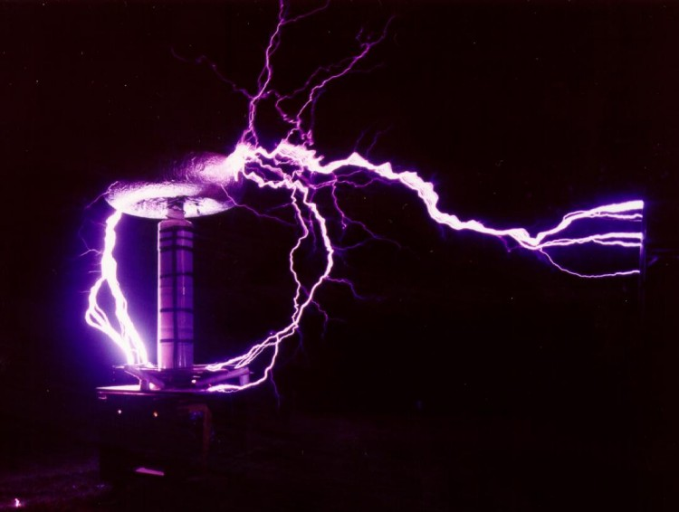
Electrostatics-L1
Institut de Physique et Ingénierie

Slide 3
Electrostatics – General contents
Chapter I: Introduction and Concepts
Chapter II: Examples of Electric field calculations
Chapter III: Gauss Theorem
Chapter IV: Applications
Institut de Physique et Ingénierie

Slide 4
Warning
In the present course the contents will be delivered mainly on the board.
The slides are used only to illustrates graphics or examples.
It is thus strongly adviced to write everything written on the board.
Electronic version of the lecture is not available.
Institut de Physique et Ingénierie

Slide 5
Chapter I. - Introduction and Concepts
1) Electrostatics devices
2) Electric charges
a. Ponctual charges
b. Continuous charges distributions
3) Electric forces and Electric fields
a. The Coulomb law
b. The electric field
c. Field lines
4) Electric potential and energy
a. Work of an electric force
b. Electric potential
c. Equipotential lines
5) Electric field created by superposition of charges
a. Two electric charges: Shape of the field lines
b. N electric charges
c. Continuous charges distribution
d. Energy of a system of charges
6) Symetries of the electric field
Institut de Physique et Ingénierie

Slide 6
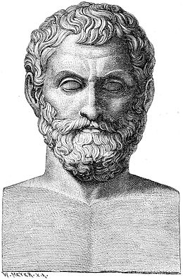
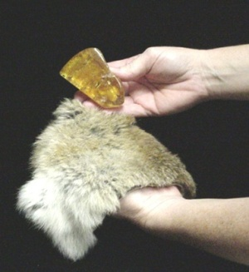
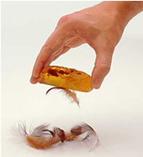
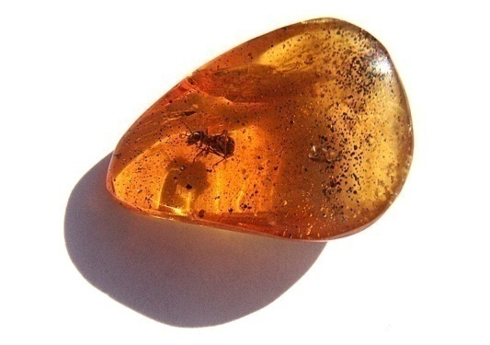
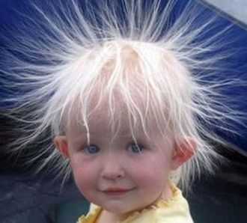
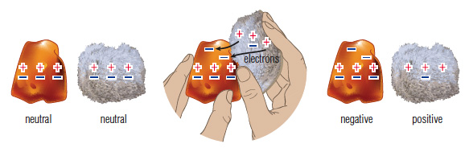
I.1) Electrostatic devices
Static Electricity
Electrisation by friction
Amber
From ancient greek:
ἤλεκτρον elektron:
Old greek
hand
Thales
625-547 BC
After rubing amber with, it can attract light objects
M
Modern explanation
Institut de Physique et Ingénierie

Slide 7
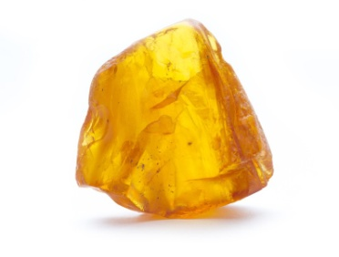

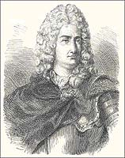
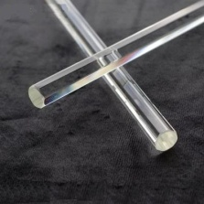
I.1) Electrostatic devices
Two types of electricity
Electricity is seen as a fluid
Resineous electricity:
obtained after friction with amber
Vitreous electricity:
obtained after friction with glass
Charles Du Fay
1698-1739
2 pendulums
rubbed with amber
REPULSION
2 pendulums
rubbed with glass
REPULSION
1 pendulum rubbed with glass and
1 pendulum rubbed with amber
ATTRACTION
Institut de Physique et Ingénierie

Slide 8
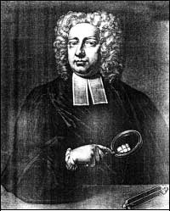
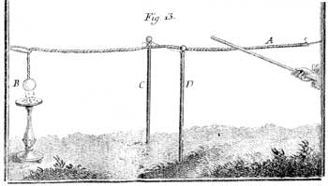
I.1) Electrostatic devices
Propagation of electricity: conductor-insulator
One can propagate electricity
existence of materials that propagate electric fluids
and others not.
Electrisation by contact
with a glass stick
Stephen Gray
1666-1736
The electric fluid propagates until the sphere because it attracts little papers
Institut de Physique et Ingénierie

Slide 9
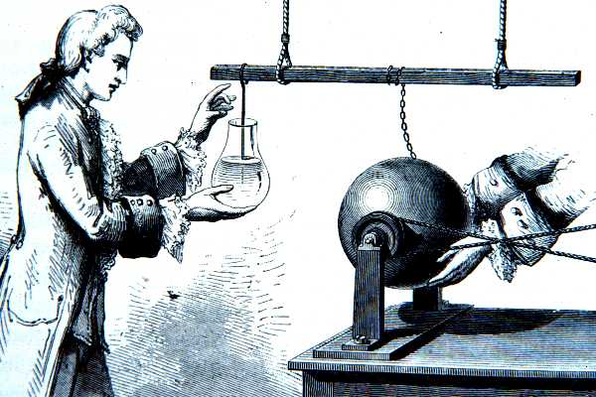
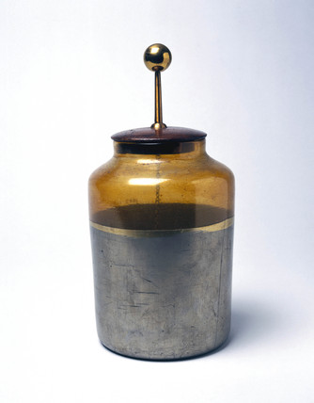
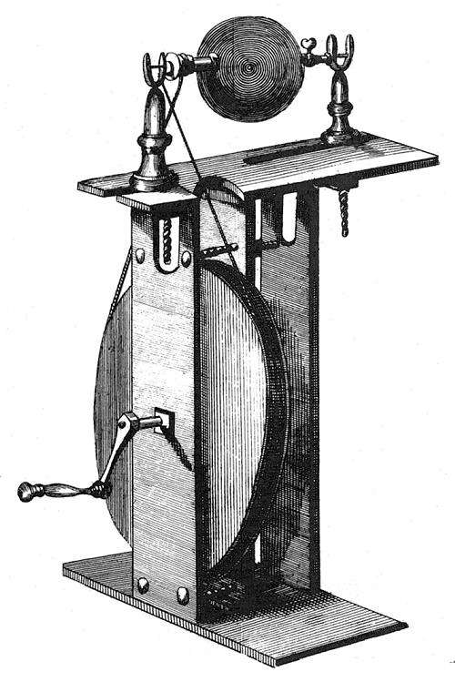
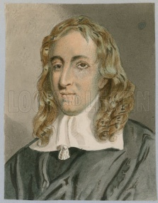
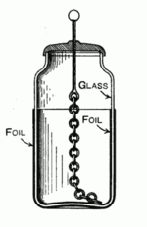
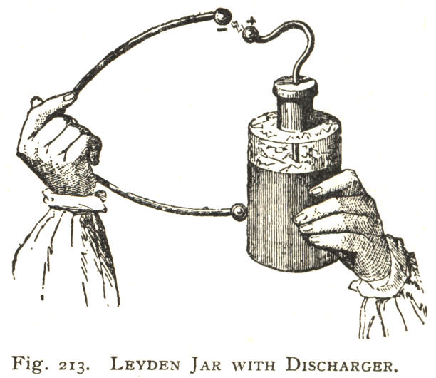
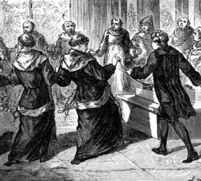
I.1) Electrostatic devices
Eletrostatic devices
1746: University of Leiden
Pieter van Musschenbroek (1692-1761)
1706
Electrisation by contact with
a rotating sulfur sphere
Leiden Jar (bottle)….first capacitor
Deliver electric discharge
Francis Hauksbee
1666-1713
Institut de Physique et Ingénierie

Slide 10
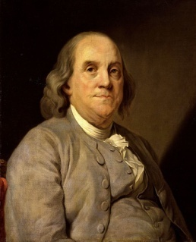

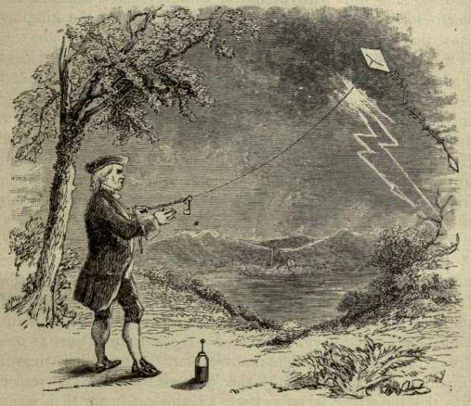
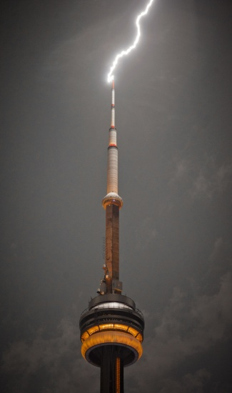
I.1) Electrostatic devices
Negative and Postives charges
Vitreous electricity and resineous electricity represent the same fluid at different pressures, the circulation of electricity put the two states at equilibrium.
Benjamin Franklin
1706-1790
- - - - - - - - -
- - - - - - - - -
+
+
+
+ + + + + + +
+ + + + + + +
Charge conservation
Phenomena acting at distance
Explanation of Leiden jar phenomena
Lightning rod
Institut de Physique et Ingénierie

Slide 11


I.1) Electrostatic devices
Interpretation of Leyden Jar
Internal
Metallic
Foil
External
Metallic
Foil
Metallic Chain propagates electric perturbation to the internal foil
+
+
+
+
-
-
-
-
-
Glass: Insulating
space between
the two foils
Possibility to close the circuit and to induce an electric discharge !!
Institut de Physique et Ingénierie

Slide 12
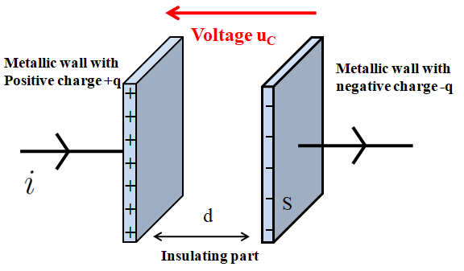
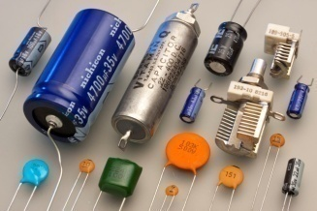
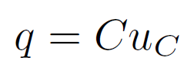
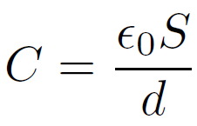
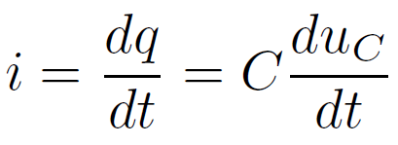
I.1) Electrostatic devices
Quick Modern description: Principle of a capacitor
Can accumulate and stock electric charges:
+
-
Electric symbol
Described by its Capacitance C (or capacity) in Farad (Coulomb/Volt):
(if insulating part is the vaccum)
C: from µF to pF
Relation between current and voltage
Institut de Physique et Ingénierie

Slide 13
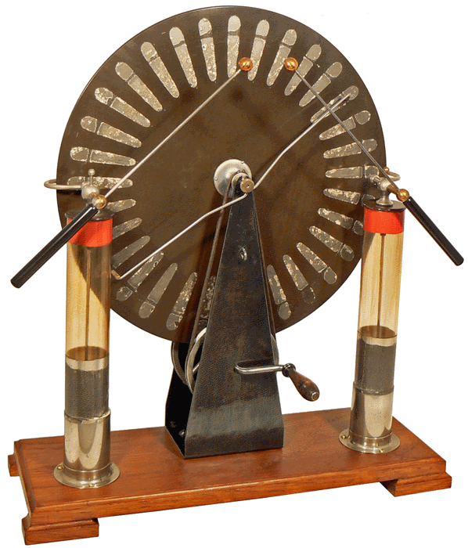
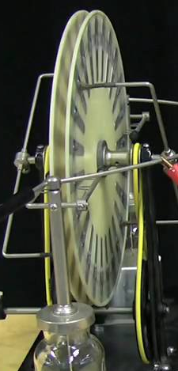
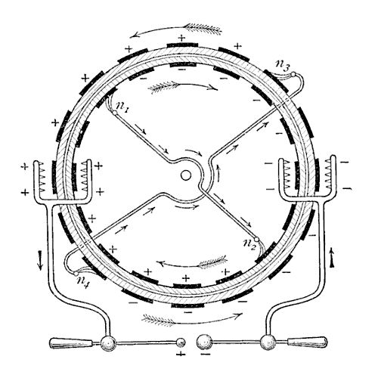
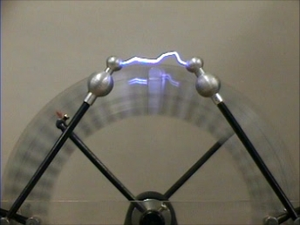
I.1) Electrostatic devices
Wimshurst Machine (1882)
Two wheels rotating in opposite direction in contact with metallic brushes.
Creation of negative charge induces apparition of a a positive charge on the other side of the brush
By the weels rotation, charges are transported and collected
When electric charges become to high: lightning
You Might watch
https://www.youtube.com/watch?v=Zilvl9tS0Og
Institut de Physique et Ingénierie

Slide 14
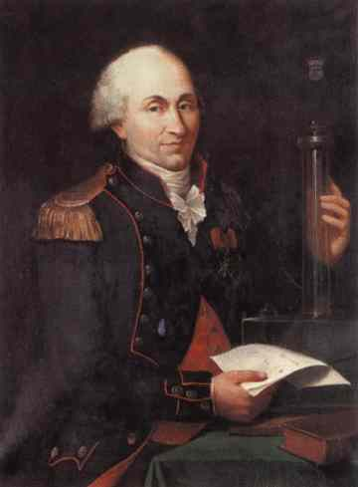
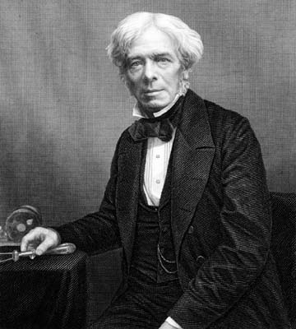
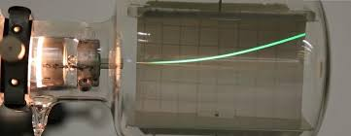
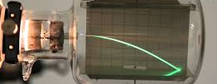
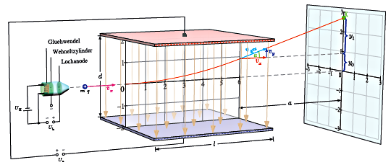
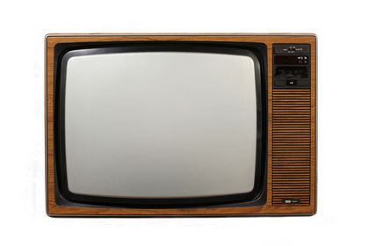

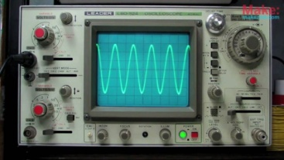
I.1) Electrostatic devices
Electric force…and Electric field…. And use to drive
electric charges !!
+ + + + + +
F
- - - - - -
Charles Coulomb
1736-1806
Michael Faraday
1791-1867
- - - - - -
F
+ + + + + +
F= q E q<0
Institut de Physique et Ingénierie

Slide 15
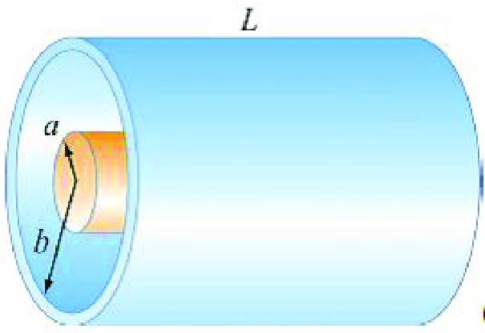

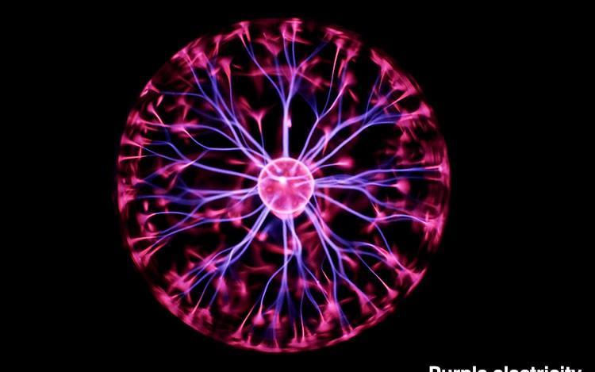
I.1) Electrostatic devices
Important question of that Electrostatic lecture….
How is the Electric field created by the electrostatic devices ????
E ??
How can we connect it to capacitance C ?? Voltage ?? Energy ??
Institut de Physique et Ingénierie

Slide 16
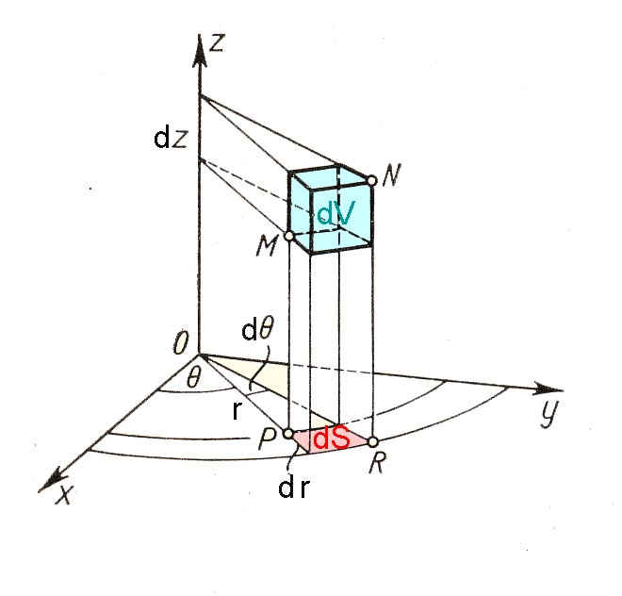
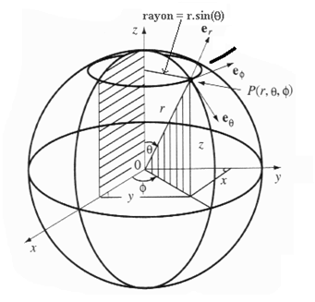
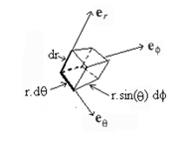
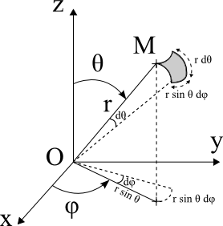
I.2) Electric charges
b) Continuous charges distribution
Infinitesimal volumes and surfaces cylindric and polar coordinates
dS=rdθdz
dV=rdrdθdz
dV=drdS
=r²dr sinθdθ dφ
dS=rdθ rsinθdφ
= r²sinθdθ dφ
dS=rdθdr
Advices
Review L0: Tutorial of second semester
Mathematical tools for Physics
Institut de Physique et Ingénierie

Slide 17
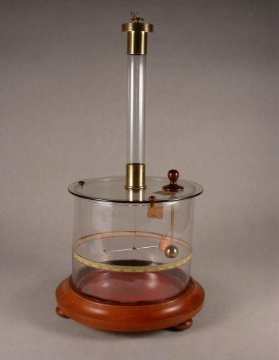
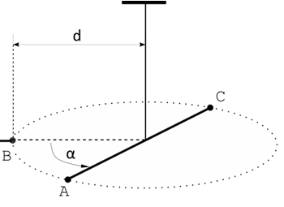
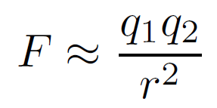
I.3) Electric Forces and Electric fields
a) The Coulomb law
Parameters that influence the electric force
Coulomb balance: device composed with a torsion balance able
to measure weak electric forces.
Charles Coulomb
1736-1806
Repulsion of two spheres after electrisation
of neutral sphere A by charged sphere B.
Coulomb: unit of electric charge
Institut de Physique et Ingénierie

Slide 18
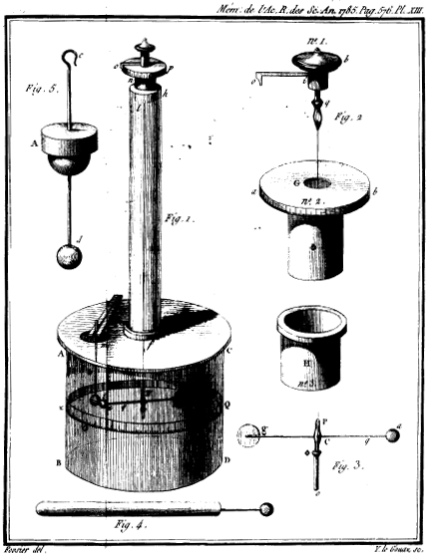
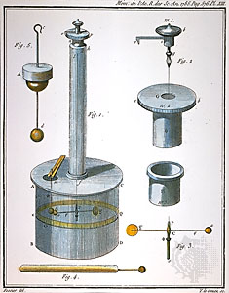
I.3) Electric Forces and Electric fields
a) The Coulomb law
Institut de Physique et Ingénierie

Slide 19
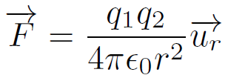




I.3) Electric Forces and Electric fields
a) The Coulomb law
Electric Force
q₁>0
q₂<0
Coulomb Force
r
Attraction or repulsion of
electric charges
Institut de Physique et Ingénierie

Slide 20




I.3) Electric Forces and Electric fields
b) The Electric field
Electric field
q₁>0
q₂<0
r
Force felt by particule 2 due to electric field 1
q₁>0
q₂<0
Institut de Physique et Ingénierie

Slide 21


I.3) Electric Forces and Electric fields
b) The Electric field
Electric field
q₁>0
q₂<0
r
Force felt by particule 2 due to electric field 1
q₁>0
q₂<0
Institut de Physique et Ingénierie

Slide 22

I.3) Electric Forces and Electric fields
c) Fields line
Electric field in three dimensionnal space
In the planes…
q₁>0
q₂<0
r
r
Institut de Physique et Ingénierie

Slide 23

I.4) Electric potential and energy
c) Equipotential lines
Field lines
V₂ < V₁
V₁
Equipotential lines
Institut de Physique et Ingénierie

Slide 24


I.4) Electric potential and energy
c) Equipotential lines
Topography of Electric potential V created by a ponctual charge
q>0
q<0
Institut de Physique et Ingénierie

Slide 25

I.5) Electric field created by superposition of charges
a)Two electric charges
Superposition: electric field created by two charges
q₁>0
q₂<0
r
r
Institut de Physique et Ingénierie

Slide 26





I.5) Electric field created by superposition of charges
a)Two electric charges
Superposition: electric field created by two charges
2
q₁>0
q₂<0
r
r
Institut de Physique et Ingénierie

Slide 27

I.5) Electric field created by superposition of charges
a)Two electric charges
Electric field created by two charges
Field lines
q₁ and q₂ equal and <0
q₁ and q₂ opposite
Institut de Physique et Ingénierie

Slide 28


I.5) Electric field created by superposition of charges
a)Two electric charges
Electric field created by two charges
Field lines
Equipotential lines
q₁ and q₂ equal and <0
q₁ and q₂ opposite
Institut de Physique et Ingénierie

Slide 29


I.5) Electric field created by superposition of charges
a)Two electric charges
Electric field created by two charges
Topography of Electric potential V
!! (q>0 on map….)
Should go down !!
Institut de Physique et Ingénierie

Slide 30




I.5) Electric field created by superposition of charges
b) N electric charges
M
Institut de Physique et Ingénierie

Slide 31



I.5) Electric field created by superposition of charges
b) N electric charges
Institut de Physique et Ingénierie

Slide 32
I.5) Electric field created by superposition of charges
b) N electric charges
Institut de Physique et Ingénierie

Slide 33

I.5) Electric field created by superposition of charges
b) N electric charges
Institut de Physique et Ingénierie

Slide 34








I.5) Electric field created by superposition of charges
c) Continuous charges distribution
Calculation of the total field produced by charge distribution
1. We consider first elementary field produced by element dx of charge dq
M
r
2. Total field is the sum of the field created by all elements dqi
M
r_{i}
Can be written as an integral form
Institut de Physique et Ingénierie

Slide 35




I.5) Electric field created by superposition of charges
c) Continuous charges distribution
ELECTRIC FIELD
For a lineic distribution we have an integral
r
M
For a surface distribution we have a double integral
r
For a volumic distribution we have a triple integral
Institut de Physique et Ingénierie

Slide 36
I.5) Electric field created by superposition of charges
c) Continuous charges distribution
ELECTRIC POTENTIAL
For a lineic distribution we have an integral
r
M
V
For a surface distribution we have a double integral
r
V
For a volumic distribution we have a triple integral
V
Institut de Physique et Ingénierie

Slide 37


I.5) Electric field created by superposition of charges
c) Continuous charges distribution
We will see during lecture the electric field and potential of some distributions
wire (1D) crown (2D) disc (2D) plan (2D) cylinder (3D) sphere (3D)
Method(s)
First calculation of electric field
and then electric potential by integration
OR
2) First calculation of electric potential
and then electric field by derivation
Institut de Physique et Ingénierie

Slide 38


I.6) Symmetries of the electric field
Symmetry of the electric charge distribution
+
+
PLAN OF SYMMETRY
PLAN OF ANTI- SYMMETRY
Institut de Physique et Ingénierie

Slide 39
I.6) Symmetries of the electric field
Symmetry of the electric charge distribution
+
+
PLAN OF SYMMETRY
PLAN OF ANTI- SYMMETRY
An electric field created in a point o f the plane of symmetry belongs to the plane
An electric field created in a point of the plane of anti- symmetry is perpendicular to the plane
Institut de Physique et Ingénierie

Slide 40
I.6) Symmetries of the electric field
Symmetry of the electric charge distribution
+
dθ
+
+
z+dz
+
+
+
+
+
+
+
θ
+
+
+
+
z
+
+
+
+
+
+
+
+
+
SYMMETRY OF TRANSLATION
ρ(x,y,z)=ρ(x,y)
SYMMETRY OF ROTATION
ρ(r,θ) =ρ(r)
ρ(z+dz) =ρ(z)
ρ(θ+dθ) =ρ(θ)
Institut de Physique et Ingénierie

Slide 41
I.6) Symmetries of the electric field
Cylindrical symmetry
Finite cylinder
Plan in the middle of the cylinder
Any plan that goes through the center of base
Institut de Physique et Ingénierie

Slide 42
I.6) Symmetries of the electric field
Cylindrical symmetry
An electric field created in a point o f the plane of symmetry belongs to the plane
Institut de Physique et Ingénierie

Slide 43
I.6) Symmetries of the electric field
Cylindrical symmetry
Infinite cylinder
…..
Infinity of middle of cylinder
F(r,θ,z)=F(r)
Institut de Physique et Ingénierie

Slide 44
I.6) Symmetries of the electric field
Spherical symmetry
F(r,θ,φ)=F(r)
Any axis that goes through the center
Institut de Physique et Ingénierie

Slide 45
Chapter II. - Examples of electric field calculations
1) Electric field created by a charged electric wire
a. Calculation of the electric field
b. Calculation of the electric potential
c. Limit case of the infinite wire.
d. Analysis in terms of field lines
2) Some examples of 2D electric charged structures
a. Electric field and electric potential created by a crown and a disc
b. Limit case of the infinite charged plane
c. Analysis in terms of field lines
3) Application to the plane capacitor
a. Electric field and electric potential
b. Capacitance and energy.
c. Electron dynamics in a constant and uniform electric field
Institut de Physique et Ingénierie

Slide 46


II.1) Electric field created by a charged electric wire
Exercise 1: Electric field created by an infinite charged wire
Electric field has a radial direction perpendicular
To the axis of the wire
Institut de Physique et Ingénierie

Slide 47



II.1) Electric field created by a charged electric wire
Interpretation in terms of Field lines !!
ZOOM on
field lines
created by
two charges
Orientation of
Electric field vector is
parallel to the field lines
Institut de Physique et Ingénierie

Slide 48
II.1) Electric field created by a charged electric wire
Interpretation in terms of Field lines !!
ZOOM on
field lines
created by
two charges
Orientation of
Electric field vector is
parallel to the field lines
Institut de Physique et Ingénierie

Slide 49


II.2) Electric field created by 2D electric charged structure
The infinite plane
+++++++
Electric field is constant and
perpendicular to the plane
Institut de Physique et Ingénierie

Slide 50
II.2) Electric field created by 2D electric charged structure
Interpretation in terms of field lines:
plane is an infinite sum of infinte wires
ZOOM on two nearest wire s
+++++++
+
+
+
+
+
+
+
+
+
+
Institut de Physique et Ingénierie

Slide 51
II.2) Electric field created by 2D electric charged structure
Interpretation in terms of field lines:
plane is an infinite sum of wires
Vision from the top
to the bottom (3 wires)
+
+
+
ZOOM on two nearest wires
+++++++
+
+
+
+
+
+
+
+
+
+
Institut de Physique et Ingénierie

Slide 52
II.2) Electric field created by 2D electric charged structure
Interpretation in terms of field lines:
plane is an infinite sum of wires
Vision from the top
to the bottom (3 wires)
+
+
+
ZOOM on two nearest wires
+++++++
+
+
+
+
+
+
+
+
+
+
+
+
+
Institut de Physique et Ingénierie

Slide 53
II.3) Application to plane capacitor
Application to plane capacitor
Plane Capacitor can be….
….the sum of two charged and
opposites planes separated from distance d
Described by its Capacitance C (or capacity) in Farad (Coulomb/Volt):
(if insulating part is the vaccum)
C: from µF to pF
(cylindrical and plane
Capacitors)
Relation between current and voltage
Institut de Physique et Ingénierie

Slide 54
II.3) Application to plane capacitor
Electric field
position z=-d/2
+++++++
z=-d/2
E
-E
Institut de Physique et Ingénierie

Slide 55
II.3) Application to plane capacitor
Electric field
position z=-d/2
+++++++
z=-d/2
E
-E
position z=d/2
-------
z=d/2
E
-E
Institut de Physique et Ingénierie

Slide 56
II.3) Application to plane capacitor
We superpose the two configurations
Electric field
+++++++
z=-d/2
z=d/2
-------
E
-E
outside
cancel
outside
cancel
Inside:
addition
Institut de Physique et Ingénierie

Slide 57
II.3) Application to plane capacitor
We superpose the two configurations
Electric field
z=-d/2
z=d/2
2E
+++++++
-------
E
0
0
-E
outside
cancel
outside
cancel
Inside:
addition
We obtain a capacitor:
electric field is only INSIDE !
Institut de Physique et Ingénierie

Slide 58

II.3.c) Electron dynamics in a constant and uniform electric field
Two charged plates: creation of uniform electric field
Device used to accelerate and/or
deviate charged particle
See exercise 7 in Tutorial of Dynamics
Institut de Physique et Ingénierie

Slide 59






II.3.c) Electron dynamics in a constant and uniform electric field
Motion equation with electric field along positive x axis
(contrary than previous slide where electric field is along y axis)
Accelerates (and deviates) charge particles
q>0
Accelerated rect motion (1D)
q>0
Accelerated parabolic motion (2D)
Institut de Physique et Ingénierie

Slide 60
Chapter III. –Gauss theorem
1) Need of Geometry
a. Notion of vector flux
b. Solid Angle
2) Statement of Gauss theorem
3) Direct applications
a. Electric field created by an infinite wire
b. Electric field created by an infinite plane
4) Electric field calculations
a. Empty and full charged cylinder
b. Empty and full sphere
4) Cylindrical Capacitors
5) Earth as a Capacitor
Institut de Physique et Ingénierie

Slide 61




III.1a) Notion of vector flux
V
V . dS : maximum
Flux of V through surface dS is maximum
Institut de Physique et Ingénierie

Slide 62
III.1a) Notion of vector flux
V
V . dS reduced
Flux of V through surface dS is reduced
Institut de Physique et Ingénierie

Slide 63
III.1a) Notion of vector flux
V
V . dS = 0
Flux of V through surface dS is zero !!
Institut de Physique et Ingénierie

Slide 64

III.1b) Solid angle under which is seen a closed surface
Point O is outisde the closed surface
Point O is inside the closed surface
dS₂
dS₂
n₁
n₂
O
dS₁
dS₁
We assume spherical elementary surface for
each dS
dΩ₁= u_{r}.dS₁ dΩ₂= u_{r}. dS₂
r₁² r₂²
dΩ₁ =- dΩ₂ solid angles are opposite
∫∫dΩ=0 total contribution is zero.
dS=r²sinθdθ dφ
_{π 2π}
∫∫dΩ= ∫∫ u_{r}.dS = ∫₀sinθdθ ∫₀dφ = 4 π
r²
The solid angle for all space is 4 π
Institut de Physique et Ingénierie

Slide 65


III.2) Gauss theorem
The flux of electric field crossing a closed surface is equal to the electric charge inside the volume delimited by the closed surface divided by espilon0
dS
r₂
Volume
Delimited by a
closed surface
Institut de Physique et Ingénierie

Slide 66







III.3a) Electric field created by an infinite cylinder charged in volume
Cylinder charged in volume
Institut de Physique et Ingénierie

Slide 67



III.3a) Electric field created by an infinite cylinder charged in volume
Cylinder charged in surface
Institut de Physique et Ingénierie

Slide 68
III.3a) Electric field created by an infinite cylinder charged in volume
Cylinder charged in volume
Cylinder charged in surface
Institut de Physique et Ingénierie

Slide 69








III.3a) Electric field created by an infinite cylinder charged in volume
Sphere charged in volume
R
Institut de Physique et Ingénierie

Slide 70


III.3a) Electric field created by an infinite cylinder charged in volume
Sphere charged in surface
R
Institut de Physique et Ingénierie

Slide 71
III.3a) Electric field created by an infinite cylinder charged in volume
Sphere charged in volume
R
Sphere charged in surface
R
Institut de Physique et Ingénierie

Slide 72



III.4) Cylindric Capacitor
Potential V₁ on internal cylinder
(radius R1)
Potential V₂ on external cylinder
(radius R2)
Institut de Physique et Ingénierie

Slide 73




III.4) Cylindric Capacitor
We assume cylinder charged on the surface with a negligible thickness
h
z
Difference of Potential ∆V= V₁ –V₂ between
the internal cylinder and the external cylinder
V₁
V₂
z
R₁
R₂
h=2cm
R2= 1 cm C=1.6 10⁻¹² F
R1= 5 mm
Institut de Physique et Ingénierie

Slide 74


III.5) Earth as a capacitor
Ionisation processess at an altitude of 80 km from Earth surface
Pressure ≈ 2 Pascal. UV radiation collide with molecules
Electrons are ejected into space and positive ions remain
UV
Ionosphere
IONOSPHERE
Institut de Physique et Ingénierie

Slide 75









III.5) Earth as a capacitor
Ionosphere
Electric Field and potential created by a sphere
Potential difference between ground and ionosphere
Earth capacitance
Similar to
RT= 6371 km
h =80 km C= 56,4 mF
value of Earth capacity !!
Institut de Physique et Ingénierie

Slide 76
Chapter IV. – Some applications
1) Electrostatic dipole
a- Potential and electric fields in the dipolar approximation
b- Molecules
c- Dipole-dipole interactions
2) Electrostatics of conductors
3) High Voltage breakdown
4) Electricity in the atmosphere (from Feynman lecture)
Due to lake of time, the three last topics will not be seen
Institut de Physique et Ingénierie

Slide 77
IV.1.a) Potential and electric fields in the dipolar approximation
y
M(x,y)
r
θ
N
-
O
P
+
x
-q at
-a/2
+q at
a/2
Dipolar moment: p=qNP
Institut de Physique et Ingénierie

Slide 78

IV.1.a) Potential and electric fields in the dipolar approximation
Field Lines
Normal Dipole
Dipole in the dipolar approximation: r>>a
r
a
Not valid with approximated formula close to r≈a
Institut de Physique et Ingénierie

Slide 79



IV.1.b) Molecules
Water
Hydrogen Chloride
Carbone dioxide
Even in neutral molecules
Non homogeneous repartition of electric
Charges due to electronegativity
Institut de Physique et Ingénierie

Slide 80

IV.1.b) Molecules
Institut de Physique et Ingénierie

Slide 81



IV.1.b) Molecules
Water
Hydrogen Chloride
Existence of electrostatic dipoles
Carbone dioxide
N
-
p
P
+
4
Defined from N to P in Physics
BUT
Defined from P to N in Chemistry…..
N
-
µ
P
+
Institut de Physique et Ingénierie

Slide 82
IV.1.b) Molecules
Hydrogen Chloride
Carbone dioxide
4
p=0
CO2 has no dipolar moment
Water
Institut de Physique et Ingénierie

Slide 83






IV.1.b) Molecules
Deviation of a water flow by a rubbed object
+
+
+
+
-
+
+
+
Institut de Physique et Ingénierie

Slide 84




SMALL ELECTRIC FIELD
NO ELECTRIC FIELD
θ
U = -p E cos θ
LARGE ELECTRIC FIELD
Dipole rotate in the direction of the field
Torque of a force
Anti-parallel
Energy MAX
Unstable
pE
Energy:
Parallel
Energy MIN
Stable
-pE
Institut de Physique et Ingénierie

Slide 85



POLARIZATION VECTOR is volumic contribution
of all dipoles:
Its amplitude is proportional to the applied electric field
Dielectric succeptibility: χ depends on material
Total electric field is:
Dielectric permitivity ε_{r}
Institut de Physique et Ingénierie

Slide 86


IV.1.c) Dipole-Dipole interaction
Interaction between dipoles
Institut de Physique et Ingénierie

Slide 87
IV.1.c) Dipole-Dipole interaction
Interaction between dipoles
Institut de Physique et Ingénierie

Slide 88

IV.1.c) Dipole-Dipole interaction
Interaction between dipoles
Institut de Physique et Ingénierie

Slide 89

IV.1.c) Dipole-Dipole interaction
Interaction between dipoles
Institut de Physique et Ingénierie

Slide 90
IV.2) Electrostatics of conductors
Institut de Physique et Ingénierie

Slide 91
IV.3) High voltage breackdown
Institut de Physique et Ingénierie

Slide 92
IV.4) Electricity in the atmosphere
Extracted from Feynman Lecture….
Institut de Physique et Ingénierie

